Slide 1
Supplier Name : XYZ Limited.
Company Established: 2004
Business starting date with KMART + Target ( if any ) - Year of 2011,
No of factories – 4
Group Capacity per month – 9 Million pcs/month
DIFOT F25 YTD – 82.41%
Product capability- T-shirt, Polo Shirt, Leggings, Tank top, Menswear, womenswear, Babies wear, Kids wear, Boxer, Hipster, Sting, Soft bra, ladies Dresses. Huddy, swimwear
Product categories currently doing for KMART – Babywear, Boys, Girls, Ladies, Ladies Maternity & Ladies Plus.
Vertical facility - We are set up with textile, ie. Knitting, Dyeing & Finishing, Cutting, Sewing, Finishing, Pressing & Packing with in house Screen print, Embroidery, sample Washing,
Sustainability activity if any – We have approved product certification ie. GOTS, OCS, GRS, OEKO TEX 100 & Blended, BCI Cotton, also engaged with Circular fashion partnership for waste recycle, installed solar panel with 145 capacity. Installed EGB for reduce energy, agreement sign for purchased Renewable energy certification yearly 5500 MW and Many others.
Any new investment if any - purchased Renewable energy certification to reduce GHG
Order placement track report:
Sourcing Feedback
Flexibility – Good
Execution – Good
Price – Competitive
 | Season
 | F25 |  | F26 YTD
Year | 200 Clothing - Womens | 150 KIDS - Clothing | 200 Clothing - Womens | 150 KIDS - Clothing
Quantity in Mill | 12.46 | 7.47 | 9.18 | 4.68
Value in Mill | $13.32 | $5.26 | $10.13 | $3.37
**Note | F25: Dept. D04 was bigger (Qty: 3.61 M pcs, value $6.60 M) F26: Dept D04 is bigger in value (Qty: 2.91 M pcs, value $5.47 M) Dept D11 is bigger in Qty (Qty: 5.83 M pcs, value $3.32 M)

Slide 2









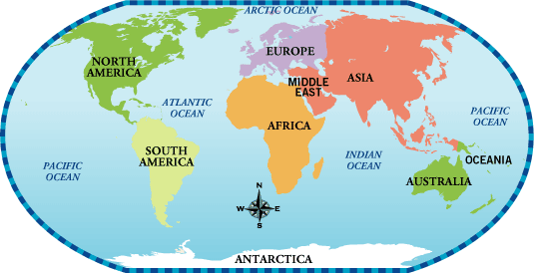
Key Customers
Co-creation
XYZ GROUP-
Knit Product (Men’s, kids, Boys, girls and Women's)
Approximately 09M Units/month
Annual Capacity 110M Units/year
115 production lines
Across all categories
$60M
$31M
$24M
$1.2M
$13M
$28M
$2.5M
Global Presence
Total Business of 2023
US $155 Million
Head office located in Dhaka, Bangladesh
Factories are in
Bangladesh
Core Strength
Transparency
In House Sewing
OPEX with Strong QA
Flexibility on cost & contingency
In-house Lab
ERP
Core Supplier for Fast Fashion Brands
Strong Design Support

