Slide 1

IT-MRM
Oct - 2024
By,
Anbu

Slide 2
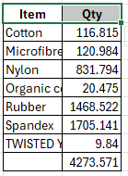
Completed - Points
Socks - Washing Project
Socks - Transport Invoice Entry– Based on Budget
Socks - Loading / Unloading Wages - Yarn store
Socks - Employee Allocation - Socks
Socks – For K-Mart Buyer, If single box scanning in multiple times system will not allow for scanning.
Socks - Yarn reverse(Automation) For MOQ Items
If JO not released, more than 10 days from the transfer date.

Slide 3
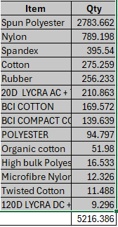
Socks – Closed Orders Raw material stock transfer to General / MOQ (automation)
1) Make To Order : Above 95% Knitting And 100% Shipped – After 2 days from the shipment date.
2)Make To Stock : 100% Knitting And 100% FG received
Socks Trims Store Project
(Location Master, Opening Stock New Screen with QR code provision
Existing GRN Screen - QR Code Provision).
Garments - Operation Portal - Data Preparation.
Garments - Checking department Grade analysis.
Garments Merch - CK automation (KPI) – U/T

Slide 4
ON Going Development - Plan
Socks Boarding Machine - R & T (Production Count And Stoppage Details).
Socks RFID Conveyor reading provision for Mix - up Articles - Kmart Buyer.
Time Saving Projects.
Completed :
Invoice Document - Combine (GRN, and Invoice) Socks & Garments – U/T
Yarn Reverse automation (Closed Orders, More than 10 days Non-Jo release MOQ Stock).
Socks Correction Tools(Fgs Scanning reverse in all levels).
Pending :
Invoice Document - Combine (GRN, Invoice) Other Divisions.
Employee allocation(Auto Posting for Production Entry Allocation Screen)
Socks - Spares Consumption Entry - Mobile App.
Socks – Within Buyer Yarn Transfer Request / Approval.
Socks – Buyer to Buyer Yarn Transfer Request / Approval.

Slide 5
Thank you

